Slide 1

Why to write and why not to
Louis Davidson
Notes:
This presentation was automatically generated by PowerPoint Copilot based on content found in this document: https://redgate365-my.sharepoint.com/personal/louis_davidson_red-gate_com/Documents/Temp/PRESENATION%20NOTES.docx AI-generated content may be incorrect.

Slide 2
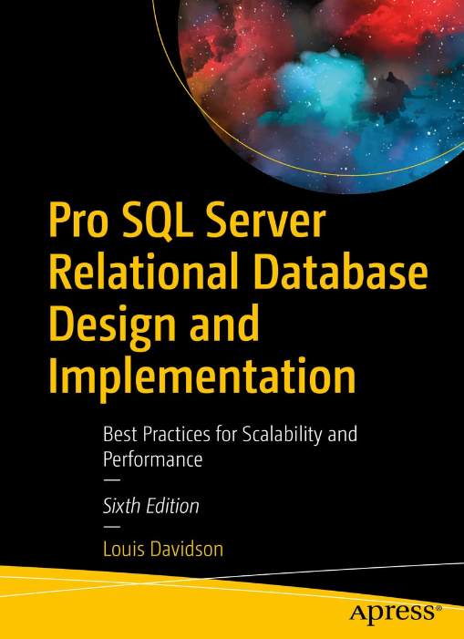

What does this presenter know about writing?
30 years
Database programmer/architect > 20 years
Former Microsoft MVP (19 Times)
Editor
Written 6 books on database design
They were technically all versions of the same book.
They at least had slightly different titles each time
Seventh Edition? Who knows
Written 500-1000 blogs
Super Brief Contact Info: DRSQL
Twitter, Website (.org), Email (@hotmail.com)

Slide 3

Presentation Format
Interactive Quiz Format
I have a set of reasons why people write
I will ask your opinion on how important this is
Then I will let you know my actual feelings
Notes:
The presentation will be in a quiz format using an app. I will present reasons and gather your feedback to understand your thoughts. Original Content: The presentation will be sort of formatted as a quiz (use an app?). Because as I put up reasons, I want your feedback to see what you were thinking.

Slide 4

Fame
The chance to be BIG in the world
Or at least the technology community

Slide 5

Reasons for Writing: Fame (20%)
Fame is possible, but…
Write about your passions and favorite toolsets
Fame happens naturally over time
You probably need to do more than just write…
Consistency is key
Choose topics wisely
Write consistently over a long period
Fame requires hard work and patience
Constantly ask your self if it is worth it.
Notes:
Fame in writing is possible but should not be the main goal. Write about your passions and be consistent. Examples include Brent Ozar, Aaron Bertrand, and Itzik Ben Gan. Fame requires hard work and time. Original Content: • Fame - 25% true Fame -(25) It is possible, but don’t make it your goal. Write about your passion, the tools you love, techniques you love etc. Fame happens. Brent Ozar is famous famous. People know whom I am. You probably have read Aaron Bertrand’s posts. Aaron posts on Simple Talk, and gets more hits than others. Same with Itzik Ben Gan. I don’t really advertise…they just get more hits than others because they have done this for a long time, chose their topics, AND did it consistently. So yeah, fame is available but it is also hard, long work

Slide 6

Community Clout
Ok, so you aren’t famous.
Here I want to talk about clout in the tech community
All of us in this room, in this conference, anyone working with technology

Slide 7

Reasons for Writing: Community Clout (90%)
Presenting
Demonstrates skills to a smaller audience
Effective but limited in reach
Writing
Shows skills to a larger audience, and for the most part, keeps on going long after a piece is posted.
Can increases community clout significantly
Combining Writing and Speaking
Enhances community clout even further
Maximizes exposure and recognition
Use one to promote the other
THE BEST FEELING: When you help future you.
Notes:
Writing is one of the best ways to gain community clout as it shows your skills to a larger audience. Presenting is also effective but reaches fewer people. Combining writing and speaking can enhance your community clout even further. Original Content: • Community Clout - 90% true Community Clout (90% true) - One of the best way to get clout in the community is to write. You might think it’s presenting and that is great too. I am not up here for my health. But the fact is that shows your skills to 30 people. writing shows your skills to many more people writing stuff about speaking and the topics are speaking about put them together and your community clout goes up even higher so absolutely community clout is a big one.

Slide 8

Office Clout
Now to your coworkers..
How are they going to react to your writing?
A blog
A book shortly after it is published?

Slide 9
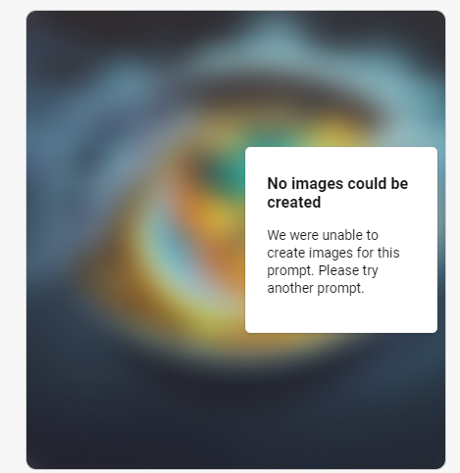
This is so unlikely that…
When I asked copilot to
“draw a picture of a person holding up a technology book, and a lot of people in an office cheering for them”
It said “no”

Slide 10
Reasons for Writing: Office Clout (10%)
It is a lot like being a doctor to your family members
Gaining clout inside your organization by doing things outside is not effective
Publishing outside your company won’t necessarily add work value
Only mixed with hard work will you get anything from it.
Potential Negative Impact
Can be perceived negatively if not careful
May turn into being seen as a jerk
Temporary Recognition
Celebration lasts only a few days
Writing a book is a lot of work, and you may just get a “meh”
Use Caution When Publishing
Handle coworkers and writing with care
Don’t use your coworkers as reference material (at least not in a recognizable way)
Notes:
Gaining clout by doing things outside your organization is not effective. Publishing outside your company won't add significant value and can be perceived negatively. Temporary recognition lasts only a few days. Handle coworkers and writing with care, as blogging or writing a book is not always impressive. Original Content: • Office Clout (Full Time Version) - 10% true Office Clout (10% true) - So I said this was 10% and that’s possibly even high. What are things you should never try to do is try to gain clout inside your organization by doing things outside your organization. I mean it doesn’t hurt (like people don’t think less of you TECHNICALLY because you publish outside of your company, but also it’s not gonna be the big value you think. No person is a profit is their own town. If you’re not careful, it can have the opposite effect and how smart you are turns into you being a jerk.So it is never gonna be celebrated more than a few days. So when you’re publishing stuff, use kid gloves when you’re dealing with your coworkers and you’re writing. popping up with I’ve got a blog on that or I wrote the book on that is not the flex. You’re gonna hope it is most likely.

Slide 11

Fortune
What about money?
Are you going to make bank on this writing endeavor?

Slide 12

Reasons for Writing: Fortune (15%)
Fortune through Writing
Gaining fortune is possible, over time.
Generally, requires working for little or no direct remuneration
Importance of Aforementioned Clout
Monetizing writing can be tied to fame and clout
Clout shows people and clients what you can do
The more clout you get, the more likely to get paid writing
Next… the paths to fortune
Notes:
Gaining fortune through writing is possible but often requires working for little pay. Platforms like Medium.com can help monetize writing. Clout is important as it showcases your work to potential clients and helps in job hunting. Original Content: • Fortune - > 15% true Fortune Another 15% - This one’s complicated and can be tied to fame a little bit. Yes, you can get fortune but mostly you’re going to work for nothing, or perhaps a pittance. There’s a couple of ways to monetize your writing, but most of that ties back to clout, but there are ones that pay money. One is medium.com that’s a really good example and another one I’m not gonna share here now. The fortune you’re gonna make is tied to cloth as it showa people and clients what you can do. When you are looking fort a job you can say ”look here’s what I’ve done” and they can go read it and see what you’ve done on your blog and social media and things like that, social media do dances and things like that

Slide 13
Three Paths to Fortune
Get a job writing
Documentation
Write a book
Find a publisher
Getting your next gig
Putting your skills on display
Helps in job hunting by showcasing your work on blogs and social media
Corporate blogs and other external communication
Marketing
Self publish
Consider writing your book as a series of blogs
You might actually have helped one of the people interviewing you.
Notes:
Gaining fortune through writing is possible but often requires working for little pay. Platforms like Medium.com can help monetize writing. Clout is important as it showcases your work to potential clients and helps in job hunting. Original Content: • Fortune - > 15% true Fortune Another 15% - This one’s complicated and can be tied to fame a little bit. Yes, you can get fortune but mostly you’re going to work for nothing, or perhaps a pittance. There’s a couple of ways to monetize your writing, but most of that ties back to clout, but there are ones that pay money. One is medium.com that’s a really good example and another one I’m not gonna share here now. The fortune you’re gonna make is tied to cloth as it showa people and clients what you can do. When you are looking fort a job you can say ”look here’s what I’ve done” and they can go read it and see what you’ve done on your blog and social media and things like that, social media do dances and things like that

Slide 14

Knowledge Portability
When you leave a company, you can’t take all the source code with you.
But what if you blog about it?

Slide 15

Reasons for Writing: Knowledge Portability (99%)
Publish on your personal time!
Ensure company policies allow this
Some companies may claim ownership of all creations, so be wary.
Guidelines
Avoid proprietary information
Do not disclose proprietary details unnecessarily
Get it? No proprietary information at all.
None
Nada
Notes:
Knowledge portability is 99% true if published on personal time and allowed by the company. Ensure company policies permit this as some may claim ownership. Avoid presenting proprietary information unless used as enticement for future purchases. Original Content: • Knowledge portability -99% true Knowledge portability (99%)- if you write on it and you publish it AND you don’t do it on Company time AND you’re allowed to by your company Then you (and the world really) own that information because you put it out on the web and that makes it so when you leave and you’ve written a cool algorithm you don’t lose it. Warning: make sure this is allowed. In some cases, your company owns everything you create. Presenting as well like I always tell people don’t present on the topic and give examples and say things like oh no I’m showing you proprietary things unless you’re showing the propriety things as kind of enticement to purchase something in the future what basically doing is saying watch quick I can’t share this. Good luck.

Slide 16

Learning New Things
Is writing a catalyst to learn new things?
Or just put out what you already know?

Slide 17

Reasons For Writing: Learning New Things (100%)
Importance of Learning
Expand your writing beyond your current knowledge
Sharing acquired knowledge through writing
Expanding Knowledge
Learning about other methods
Realizing the advantages or disadvantages of different methods
Example: Database Backups
Writing about the way you backup databases
Understanding why your method is used over others
So you need knowledge of the others…
Creating More Content
Writing more blogs with new knowledge
Covering various aspects of recovery and processes
Notes:
Learning new things is crucial for writing. It requires going beyond current knowledge and sharing it. For example, knowing one way to back up a database is good, but understanding why it's used over others enriches the story. This helps in learning more methods, creating more content, and covering various aspects of recovery. Original Content: • Learn new things - 100% Learning new things (100). One of the big values of writing is that you need to learn more than you currently know and then share it. So say you’re writing on back ups. And say you know one way to back up the database and that’s probably you know all you need for your job. That may be all you need and you are great at it. And you can write on that one way But it helps to know why you are doing it that way instead of others methods. Then your story gets richer. And then you learn about the other ways and realize they are better, or not. Now you have more blogs, and more knowledge if another org does it a different way. And you can cover more and more about recovery, and how you do this and that etc.

Slide 18

Helping Others and Feeling Good About It
Helping others is a slam dunk. If you publish a blog on your site, it will help others.
BUT: Will it always feel good?

Slide 19

Reasons to Write: Helping Others and Feeling Good (50%)
Helping others and feeling good about it
50% of the time, people feel totally good about the help they have given to others
Challenges arise because people can be “difficult”
Don’t ignore feedback entirely
Bad feedback from reputable, friendly sources is the most useful thing you can get.
We all make mistakes and have wrong ideas
Praise from reputable sources is second best
Supporting fellow writers
Give kudos and links to other writers
Or helpful negative feedback
Be a part of the writer community
Either formally or informally
Be nice. There are plenty or readers to go around
Most importantly: don’t feed the trolls
Notes:
Helping others can make you feel good, but it can be challenging. The most useful feedback is often bad feedback from reputable sources. Praise from these sources is also valuable. Support fellow writers by giving kudos and links. Be part of the community and strive to be your best. Original Content: • Helping other and feeling good about it - 50%. Helping other and feeling good about it (50) - So I was at 50% because people suck. The best feedback is bad… Maybe I should say. The most useful feedback is bad feedback…from reputable, friendly sources. We all make mistakes, we have things wrong, typos perhaps? But often just flat out wrong idea. Second best is praise from those same people. As a writer, give other writers kudos. And links. You are in competition, sure. But it isn’t that kind of competition. It is one where you want to squeak out a victory by increasing your abilities and increasing others abilities too. Brent Ozar shares links to pump up others. You should too. Be a part of the community, and try to be the best you.

Slide 20

There is a little bit of reality in all the factors we discussed
Fame
Clout in the community and your office
Fortune
Porting your knowledge from job to job
Learning new things
Helping others AND actually feeling good about it
I love writing
It isn’t always easy
It isn’t always fun
But it always feels good when you press “Publish”
Even better when you email the copy to someone to publish!
Notes:
Always take and honor feedback, whether it's good, bad, or ugly. However, don't feed the trolls after midnight. Focus on meaningful feedback and ignore unconstructive criticism. Original Content: I will leave you with this final thought. Take and honor feedback. Good, bad, and ugly. But don’t feed the trolls after midnight. Midnight on January 1, 1900.

Slide 21

Questions?

Slide 22
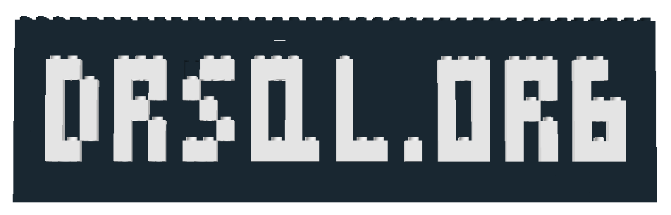

Contact info..
Louis Davidson - louis@drsql.org
Website – http://drsql.org
Get slides here: https://drsql.org/presentations
Twitter – http://twitter.com/drsql
Editor/Blogger at https://www.red-gate.com/simple-talk/author/louis-davidson/
Notes:
[twitter] Slides will be on drsql.org in the presentations area for this and the keynote as soon as I can get them out there. @rmtechtrifecta [/twitter]

Slide 23

Technical Writing Tips To Fill The Empty Spaces
(At least to start) Worry less about a pretty site and goog grammer and more about technical content.
(It does need to make some sense)
Use AI, but use it sparingly. Great for grammar, style, and inspiration. Bad for just copying verbatim.
Try to write like the best version of you speaking.
Read your work out loud if you can.
Work in real stories. Even if they aren’t really real stories.
Writer’s block is real. Make a folder of ideas and park things you can’t seem to finish.
If you are always blocked, ask if you are writing about something you want to write about.
Capture ideas 24 hours a day.
Write to the code/images/etc you have.
Really, never feed the trolls.
Notes:
This session will explore why I love and dislike writing, misconceptions about its value, and reasons others avoid it. We'll discuss personal enjoyment, creative expression, writer's block, and more. Original Content: This session will cover many of the reasons I love writing, and some of the reasons why I don’t. More importantly, it will cover some reasons you might think are valuable, but aren’t. It will also cover some of the reasons why some other people have told me they don’t get into it.

Slide 24

And then it hit me… I should write an article on each of these tips… And so it begins…

Slide 25
